Slide 1

UC Berkeley’s CS61A – Lecture 14 – Mutable Values
AMAZON ALEXA AND THE SEARCH FOR THE ONE PERFECT ANSWER www.wired.com/story/amazon-alexa-search-for-the-one-perfect-answer
“According to one market survey, people ask their smart speakers to answer questions more often than they do anything else with them. … Computers responding to our queries in a single pass—providing one-shot answers, as they are known in the search community—has gone mainstream. The internet and the multibillion-­dollar business ecosystems it supports are changing irrevocably. So, too, is the creation, distribution, and control of information—the very nature of how we know what we know. … Market analysts estimate that, by 2020, up to half of all internet searches will be spoken aloud. The conventional web, with all of its tedious pages and links, is giving way to the conversational web, in which chatty AIs reign supreme. The payoff, we are told, is increased convenience and efficiency. But for everyone who has economic interests tied to traditional web search—businesses, advertisers, authors, publishers, the tech giants—the situation is perilous”

Slide 2
Announcements
Hog Composition Scores have been released
You can find your score and any comments on your Hog submission on Ok
Submit revisions (via python3 ok --revise) by Tuesday, February 26th to recover any lost points!
Maps (SOLO – no partners) Project released and due Thursday 2/28 (3 days!)
Submit a day early (Wednesday 2/27) to receive 1 extra credit point
When would you like Homework 4 due? [HW5 is long and its due date won’t change – Thu 3/7]
Fri 3/1
Sat 3/2
Sun 3/3
Hog Contest!!
1. Dustin Luong - dstn.luong@berkeley.edu
2. Cici Xue - cicix@berkeley.edu
3. Betty Yee - bettyyee@berkeley.edu, Ajay Kosuri - ajaykosuri@berkeley.edu

Slide 3
(From Lecture 13) Tree Processing Uses Recursion
Processing a leaf is often the base case of a tree processing function
The recursive case typically makes a recursive call on each branch, then aggregates
def count_leaves(t):
"""Count the leaves of a tree."""
if is_leaf(t):
return 1
else:
branch_counts = [count_leaves(b) for b in branches(t)]
return sum(branch_counts)
(Demo5)

Slide 4
(From Lecture 13) Discussion Question
Implement leaves, which returns a list of the leaf labels of a tree
Hint: If you sum a list of lists, you get a list containing the elements of those lists
>>> sum([ [1], [2, 3], [4] ], [])
[1, 2, 3, 4]
>>> sum([ [1] ], [])
[1]
>>> sum([ [[1]], [2] ], [])
[[1], 2]
def leaves(tree):
"""Return a list containing the leaf labels of tree.
>>> leaves(fib_tree(5))
[1, 0, 1, 0, 1, 1, 0, 1]
"""
if is_leaf(tree):
return [label(tree)]
else:
return sum(______________________________, [])
List of leaf labels for each branch
branches(tree)
[b for b in branches(tree)]
leaves(tree)
[s for s in leaves(tree)]
[branches(b) for b in branches(tree)]
[branches(s) for s in leaves(tree)]
[leaves(b) for b in branches(tree)]
[leaves(s) for s in leaves(tree)]

Slide 5
(From Lecture 13) Creating Trees
A function that creates a tree from another tree is typically also recursive
def increment_leaves(t):
"""Return a tree like t but with leaf labels incremented."""
if is_leaf(t):
return tree(label(t) + 1)
else:
bs = [increment_leaves(b) for b in branches(t)]
return tree(label(t), bs)
def increment(t):
"""Return a tree like t but with all labels incremented."""
return tree(label(t) + 1, [increment(b) for b in branches(t)])
def tree_map(t,f):
"""Return a tree like t but with all labels having f applied to them."""
return tree(f(label(t)), [tree_map(b,f) for b in branches(t)])

Slide 6
Objects
(Demo1)

Slide 7
Objects
Objects represent information
They consist of data and behavior, bundled together to create abstractions
Objects can represent things, but also properties, interactions, & processes
A type of object is called a class; classes are first-class values in Python
Object-oriented programming:
A metaphor for organizing large programs
Special syntax that can improve the composition of programs
In Python, every value is an object
All objects have attributes
A lot of data manipulation happens through object methods
Functions do one thing; objects do many related things

Slide 8
Example: Strings

Slide 9
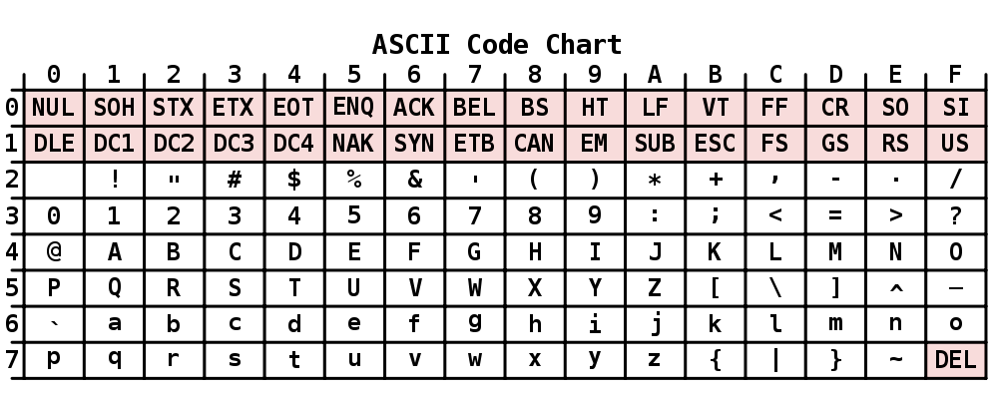
Representing Strings: the ASCII Standard
American Standard Code for Information Interchange
“Bell” (\a)
“Line Feed” (\n)
0 0 0
0 0 1
0 1 0
0 1 1
8 rows: 3 bits
1 0 0
1 0 1
1 1 0
1 1 1
16 columns: 4 bits
Layout was chosen to support sorting by character code
Rows indexed 2-5 are a useful 6-bit (64 element) subset
Control characters were designed for transmission
(Demo2)

Slide 10
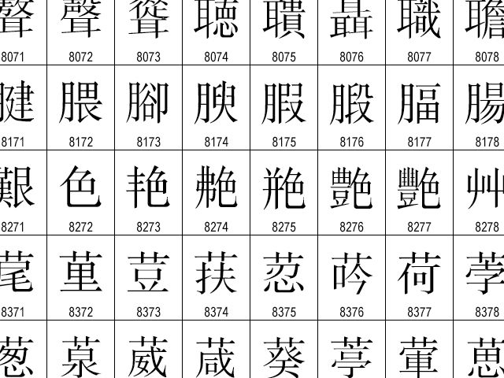
Representing Strings: the Unicode Standard
https://en.wikipedia.org/wiki/List_of_Unicode_characters
137K characters
146 scripts (organized)
Enumeration of character properties, such as case
Supports bidirectional display order
A canonical name for every character
http://ian-albert.com/unicode_chart/unichart-chinese.jpg
LATIN CAPITAL LETTER A
'🏀'
'♪'
BASKETBALL AND HOOP
EIGHTH NOTE
(Demo3)

Slide 11
Mutation Operations

Slide 12
Some Objects Can Change
https://en.wikipedia.org/wiki/Playing_card_suit
[Demo4]
First example in the course of an object changing state
The same object can change in value throughout the course of computation
👶
👧
👩
jessica
👵
same_person
Unicode character name
OLDER WOMAN
BABY
WOMAN
GIRL
All names that refer to the same object are affected by a mutation
Only objects of mutable types can change: lists & dictionaries
{Demo5}

Slide 13
Mutation Can Happen Within a Function Call
A function can change the value of any object in its scope
>>> four = [1, 2, 3, 4]
>>> len(four)
4
>>> mystery(four)
>>> len(four)
2
def mystery(s):
s.pop()
s.pop()
or
def mystery(s):
s[2:] = []
>>> four = [1, 2, 3, 4]
>>> len(four)
4
>>> another_mystery() # No arguments!
>>> len(four)
2
def another_mystery():
four.pop()
four.pop()
pythontutor.com/composingprograms.html#code=def%20mystery%28s%29%3A%0A%20%20%20%20s.pop%28%29%0A%20%20%20%20s.pop%28%29%0A%0Afour%20%3D%20[1,%202,%203,%204]%0Amystery%28four%29&mode=display&origin=composingprograms.js&cumulative=true&py=3&rawInputLstJSON=[]&curInstr=0

Slide 14
Tuples
(Demo6)

Slide 15
Tuples are Immutable Sequences
Immutable values are protected from mutation
>>> turtle = (1, 2, 3)
>>> ooze()
>>> turtle
(1, 2, 3)
>>> turtle = [1, 2, 3]
>>> ooze()
>>> turtle
['Anything could be inside!']
Next lecture: ooze can change turtle's binding
The value of an expression can change because of changes in names or objects
>>> x = 2
4
>>> x = 3
6
>>> x = [1, 2]
[1, 2, 1, 2]
>>> x.append(3)
[1, 2, 3, 1, 2, 3]
>>> x + x
>>> x + x
>>> x + x
>>> x + x
Name change:
Object mutation:
An immutable sequence may still change if it contains a mutable value as an element
>>> s = ([1, 2], 3)
>>> s[0] = 4
ERROR
>>> s = ([1, 2], 3)
>>> s[0][0] = 4
>>> s
([4, 2], 3)

Slide 16
Mutation

Slide 17
Sameness and Change
As long as we never modify objects, a compound object is just the totality of its pieces
A rational number is just its numerator and denominator
This view is no longer valid in the presence of change
A compound data object has an "identity" in addition to the pieces of which it is composed
A list is still "the same" list even if we change its contents
Conversely, we could have two lists that happen to have the same contents, but are different
>>> a = [10]
>>> b = a
>>> a == b
True
>>> a.append(20)
>>> a
[10, 20]
>>> b
[10, 20]
>>> a == b
True
>>> a = [10]
>>> b = [10]
>>> a == b
True
>>> b.append(20)
>>> a
[10]
>>> b
[10, 20]
>>> a == b
False

Slide 18
Identity Operators
Identity
<exp0> is <exp1>
evaluates to True if both <exp0> and <exp1> evaluate to the same object
Equality
<exp0> == <exp1>
evaluates to True if both <exp0> and <exp1> evaluate to equal values
Identical objects are always equal values
(Demo)

Slide 19
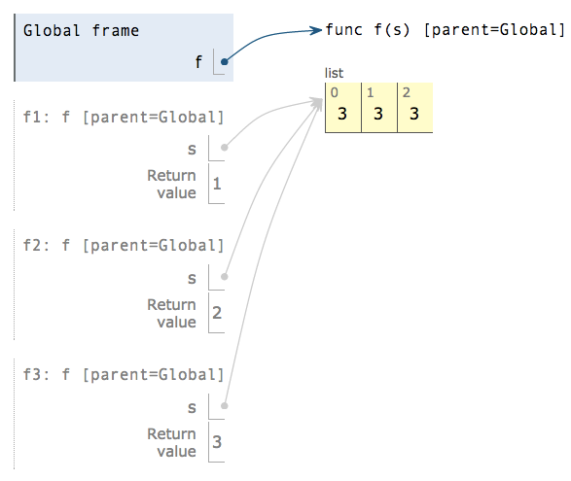
Mutable Default Arguments are Dangerous
A default argument value is part of a function value, not generated by a call
>>> def f(s=[]):
... s.append(3)
... return len(s)
...
>>> f()
1
>>> f()
2
>>> f()
3
Each time the function is called, s is bound to the same value!
pythontutor.com/composingprograms.html#code=def%20f%28s%3D[]%29%3A%0A%20%20%20%20s.append%283%29%0A%20%20%20%20return%20len%28s%29%0A%20%20%20%20%0Af%28%29%0Af%28%29%0Af%28%29&mode=display&origin=composingprograms.js&cumulative=true&py=3&rawInputLstJSON=[]&curInstr=0

